Slide 1

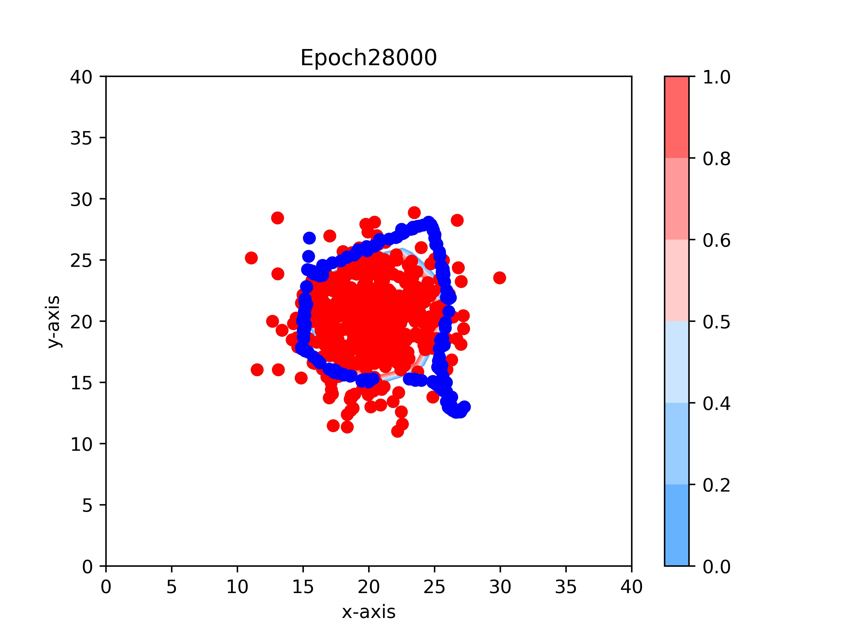
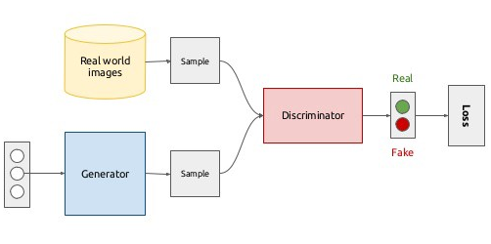
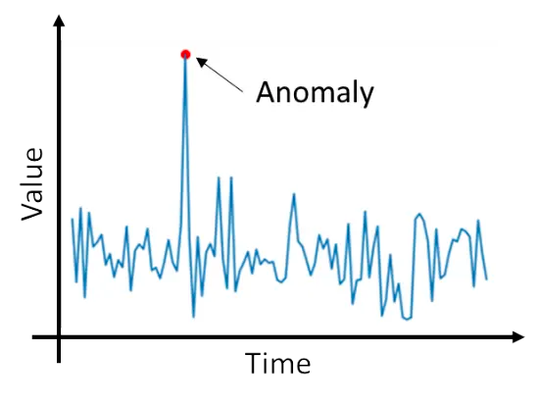
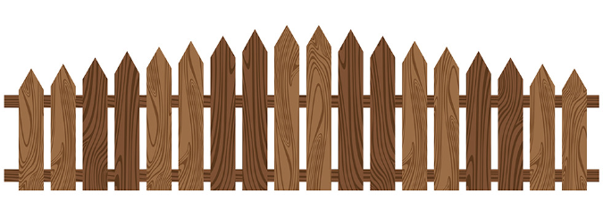
Fence GAN for Anomaly Detection
Timothy Antoni
20 September 2023
A*STAR BII

Slide 2
1. Introduction

Slide 3
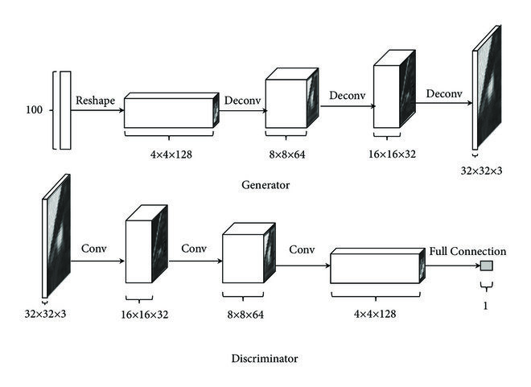
Generative Adversarial Network (GAN)
GAN is a Deep Learning framework consisting of:
Generator (G), produces fake data (image) that resembles real data using Transposed Convolutional Neural Network
Discriminator (D), critiques the similarity of the images generated by G to the real data using Convolutional Neural Network
Objective: Generated Data distribution overlaps Real Data Distribution.

Slide 4
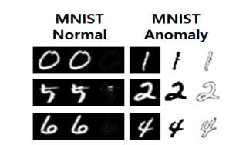
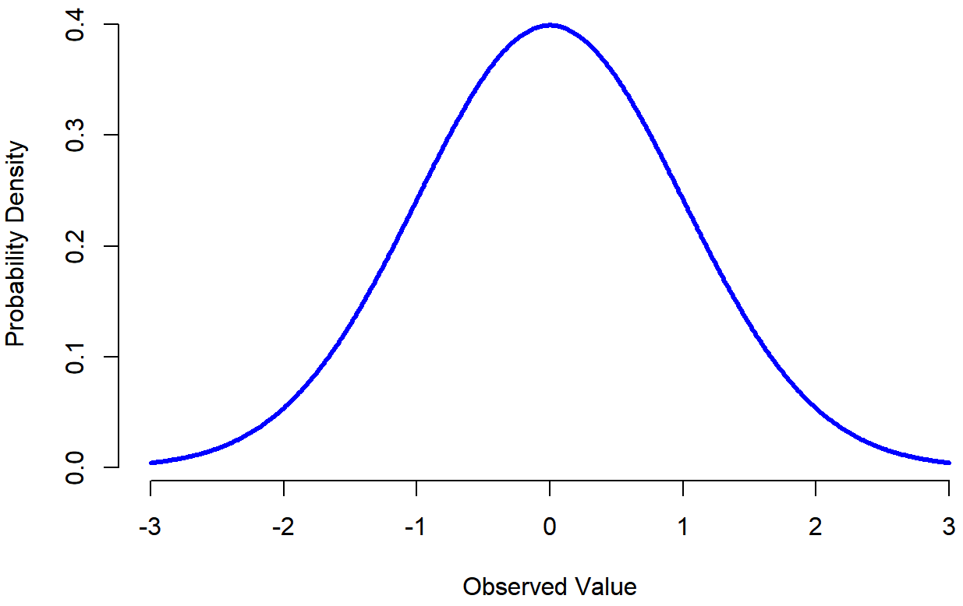
Anomaly Detection using GAN
GAN Discriminator score can be used as the probability of the image input being real. [Range 0 to 1]
However, [2] found that using Discriminator score as anomaly probability is ineffective for detecting anomalous data.
Score= ?

Slide 5
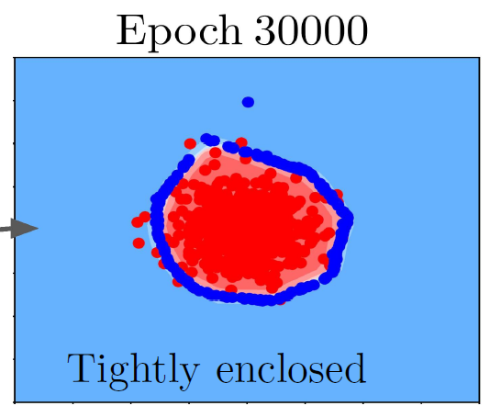
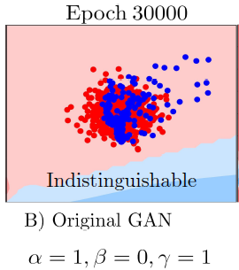
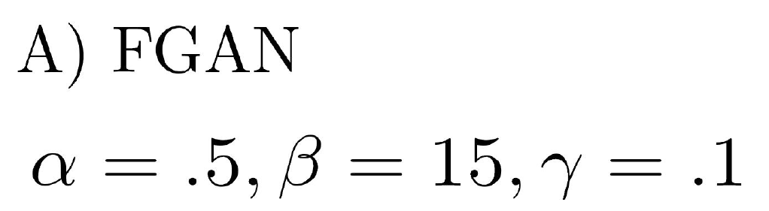
Fence GAN for Anomaly Detection
Anomaly
Real
Anomaly
Why was vanilla GAN ineffective?
Hypothesis: Overlapping distribution of generated and real data offers no explicit boundary between real and anomaly class. [1]
In FGAN, generated data is arranged to form a fence as a sharp decision boundary by modifying original GAN loss functions. It helps detect anomalies more robustly than using probability.
Anomaly Data Distribution
Real Data Distribution
Fences
Generated Data
Real Data

Slide 6
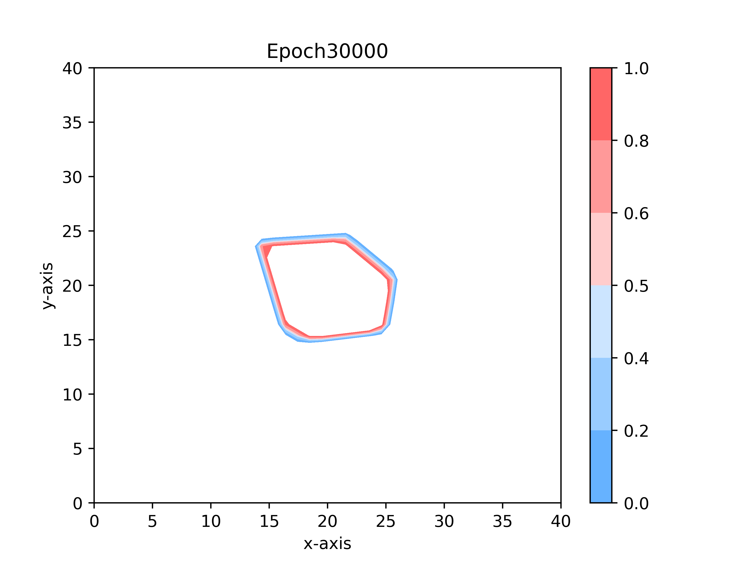
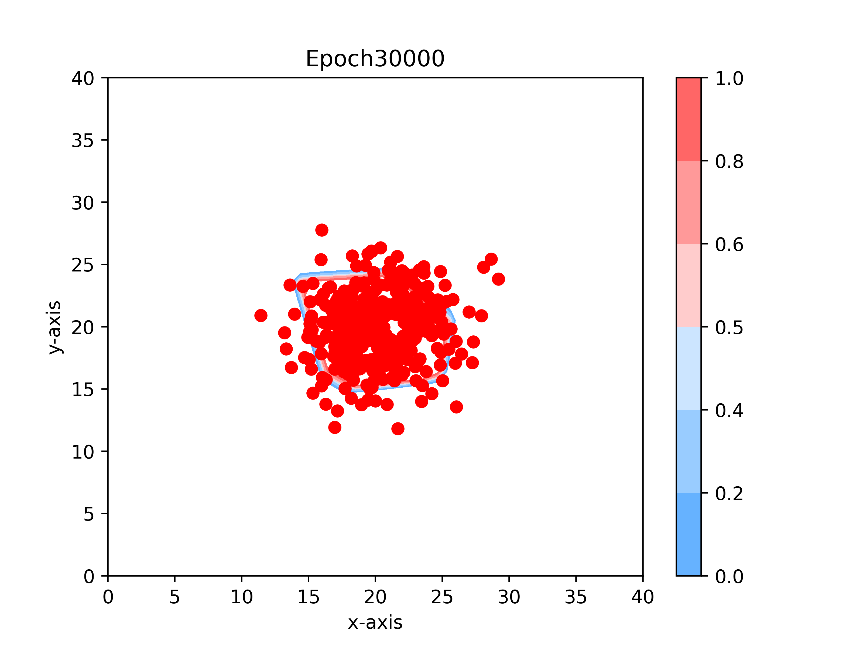
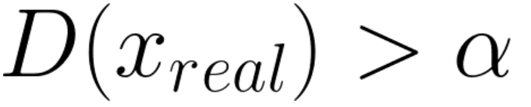
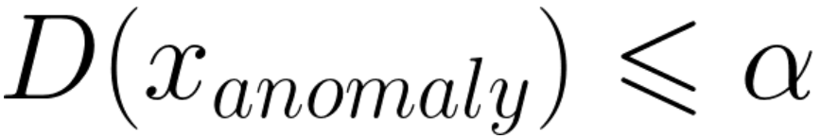
Fence GAN for Anomaly Detection
In Fence GAN, Discriminator score of the generated data serves as the decision boundary between anomalous and real data. This cutoff score is a hyperparameter, α.
Discriminator score of a test data that is bigger than cutoff score is classified real, and anomalous otherwise
Discriminator
score
Real Data

Slide 7
Disclaimer
There are 3 types of data discussed in this presentation:
Real Data, e.g. Normal network access
Anomalous Data, e.g. Intrusive network access
Generated Data: Data generated by the Generator module of GAN that functions as a “Fence” between real and anomaly

Slide 8
Related Works
Benchmarks of the paper:
AnoGAN & ADGAN (Inefficient: Iterative latent space search)
Efficient GAN (Bidirectional GAN)
GANomaly (Encoding, Reconstruction, Feature Matching Losses)
Not mentioned in the paper (but should have been):
GeoTrans (Transformation and Augmentation)
OneClassGAN (Learn latent representations constrained to one class)

Slide 9
2. Methodology

Slide 10
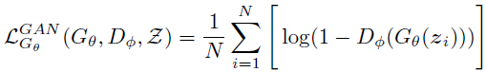
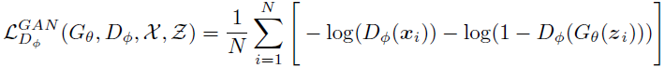
Original GAN Loss Functions
Original GAN has 2 loss functions, one for Generator and for Discriminator
Fence GAN has 3 loss functions, two for Generator and one for Discriminator.
N = No. of samples
D_{Φ}(G_{θ}(z_{i})) = Discriminator score of G(z)
G_{θ}(z_{i}) = Generated Data
x_{i} = Real Data

Slide 11
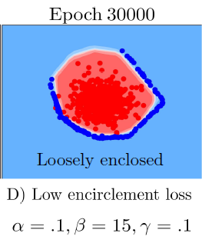
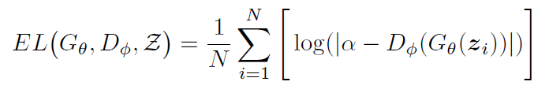
Fence GAN Innovation – Loss Function (1)
Generator Loss 1: Encirclement Loss
N = No. of samples
α = Fence Threshold Hyperparameter
D_{Φ}(G_{θ}(z_{i})) = Discriminator score of G(z)
G_{θ}(z_{i}) = Generated Data
D = α
D = 1
D = 0.1
“Form a fence where the Discriminator score would be α”

Slide 12
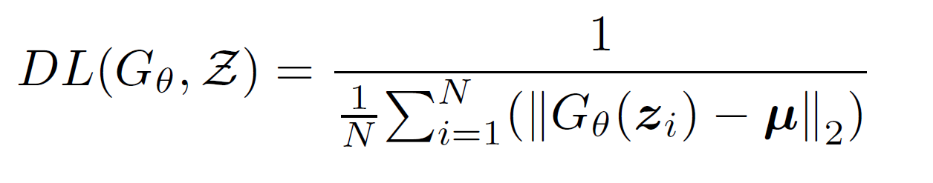
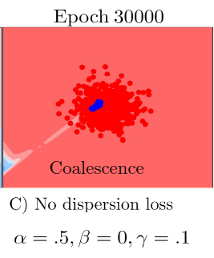
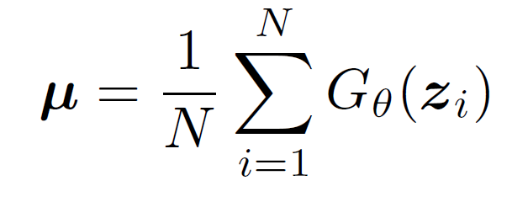
Fence GAN Innovation – Loss Function (2)
Generator Loss 2: Dispersion Loss
G_{θ}(z_{i}) = Generated Data
μ = Mean of all Generated Data
D = 1
“Disperse (Maximize the distance of) each generated data from its mean”

Slide 13
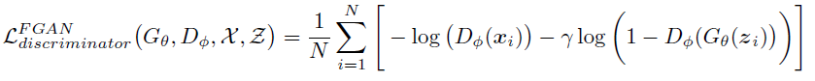
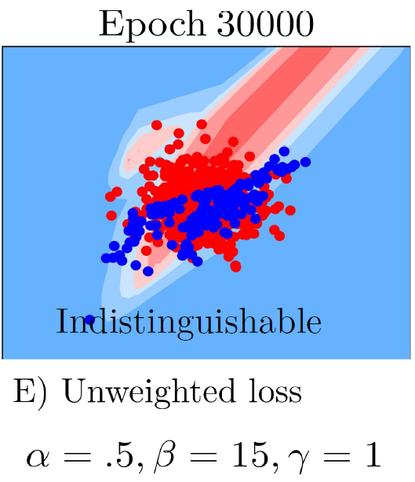
Fence GAN Innovation – Loss Function (3)
Discriminator Loss Modification:
x_{i} = Real Data
G_{θ}(z_{i}) = Generated Data
D_{Φ}(x_{i}) = Discriminator score of x_{i}
D_{Φ}(G_{θ}(z_{i}))= Discriminator score of G(z)
γ = Loss Weighting Hyperparameter
“Focus the Discriminator on classifying Real Data correctly”

Slide 14
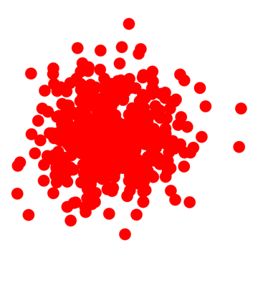
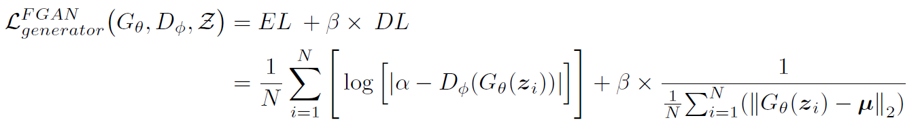
Fence GAN Loss - Summary
Summary of Losses:
{
Focus Discriminator on Real Data
Shrink
Increase α
Decrease γ
Increase TN
Increase FP
Enlarge
Decrease α
Increase γ
Increase TP
Increase FN
{
{
Fence-forming
Spread the fence
Remember,
is Negative Class
(Real Data)

Slide 15
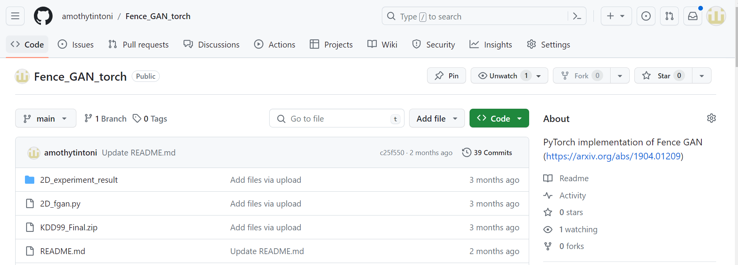
Implementation in PyTorch
Link: https://github.com/amothytintoni/Fence_GAN_torch/tree/main

Slide 16
3. Results

Slide 17
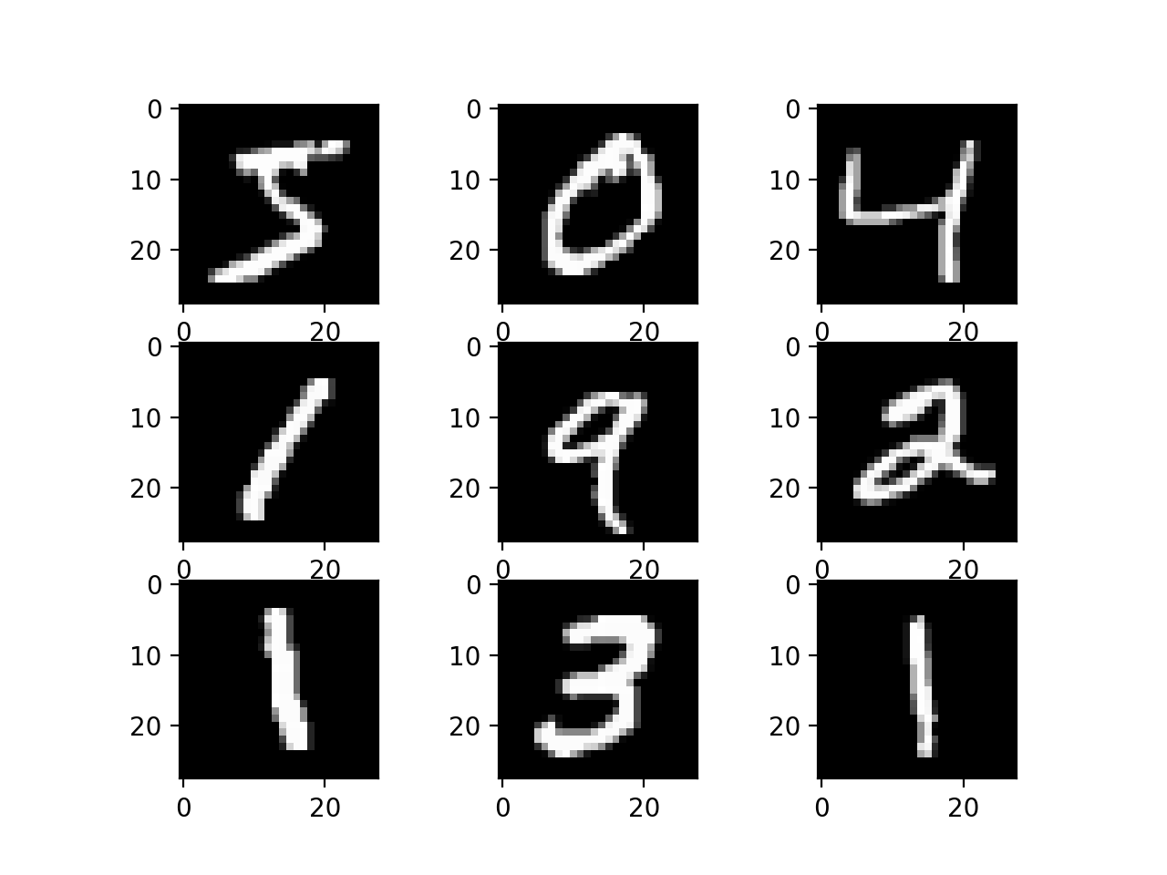
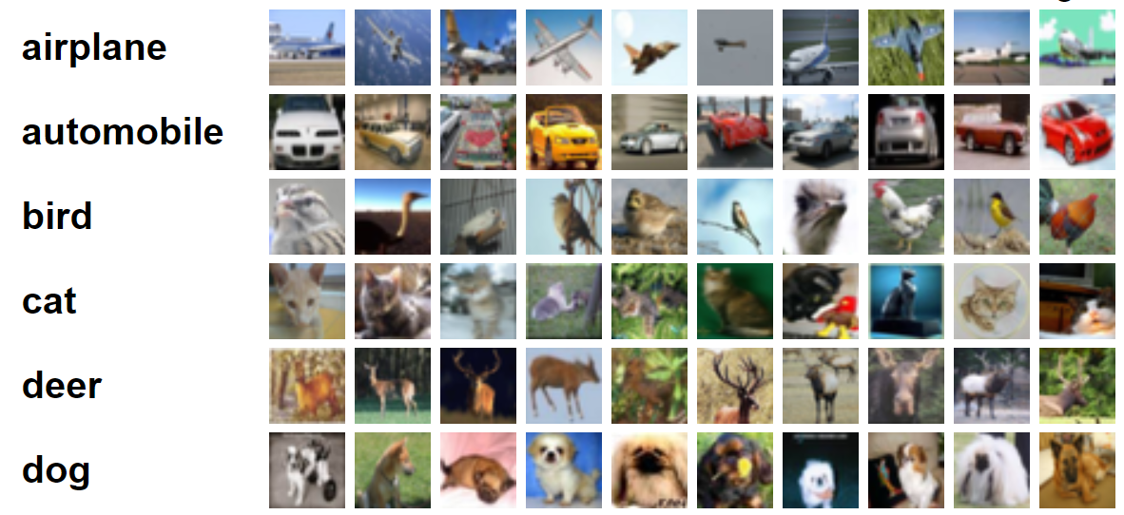
Dataset
MNIST 28x28 grayscale images of digits 0-9. 70,000 images
CIFAR-10 32x32 color images of 10 image classes. 60,000 images
KDD99 Network Intrusion Detection, tabular data. 5,200,000 rows x 42 columns

Slide 18

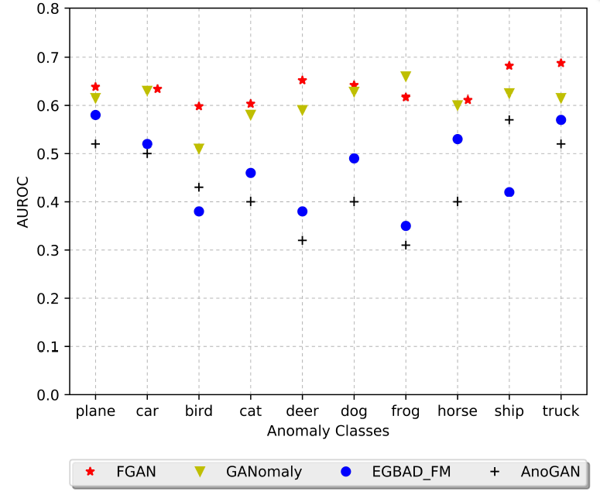
Performance
Generate results by setting one class as the anomaly class.
Fence GAN performs better than the benchmarks it lists in the paper. It is also exceptionally robust.
However…
Fence GAN (04.2019): 63% ± 3%
OCGAN (03.2019) : 66% ± 9% GeoTrans (05.2018) : 86% ± 8%
GeoTrans
OCGAN

Slide 19
4. Discussion

Slide 20
Limitations and Improvements (1)
1. Incorporate GeoTrans (Image Transformations) to the model
CIFAR-10 AUROC 63% -> 86%
Seamless integration
Simple transformations – Flip, Translation, Rotation

Slide 21
Limitations and Improvements (2)
2. Better Loss Backpropagation Method and Hyperparameter tuning
{
Improvement:
Separate vs Combined Backprop
MNIST | Anomaly Class AUPRC
Version | 0 | 1 | 2 | 3 | 4 | 5 | 6 | 7 | 8 | 9 | Mean
Paper result | 90.5 | 92.4 | 90.3 | 85.6 | 81.1 | 84.2 | 84.7 | 87.8 | 84.9 | 72.2 | 85.37
Backprop | 94.1 | 93.5 | 89.3 | 86.6 | 77.6 | 83.4 | 90.8 | 88.4 | 90 | 76.8 | 87.05
Backprop + HP | 94.1 | 93.3 | 89.9 | 87.2 | 77.8 | 85.5 | 90.6 | 88.7 | 90.2 | 76.1 | 87.34
Result:

Slide 22
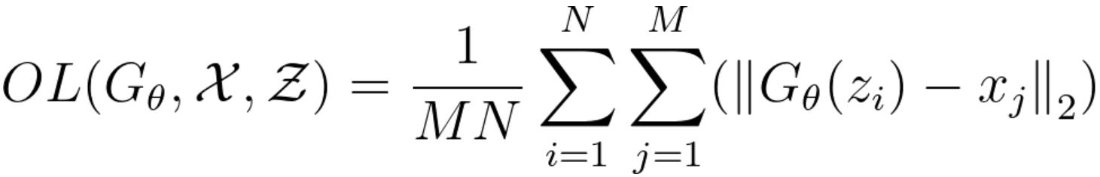
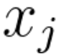
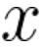
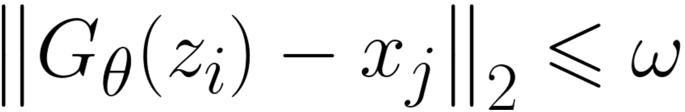
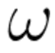
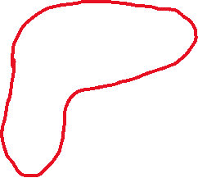
Limitations and Improvements (3)
3. If the Real Data distribution is highly irregular, circular fence may be ineffective. Introducing “Outline Loss” might help.
is all where
is the closeness hyperparameter,
set to a small value
High TP Fence
High TN Fence
Ideal Fence
Real Data

Slide 23
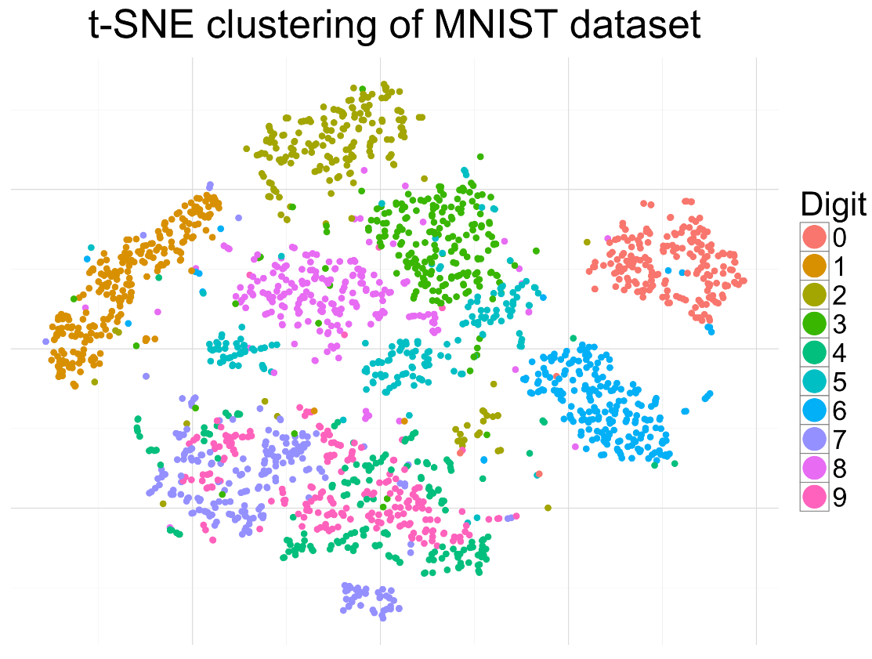

The Case for Outline Loss
FGAN Fence
Ideal Fence

Slide 24
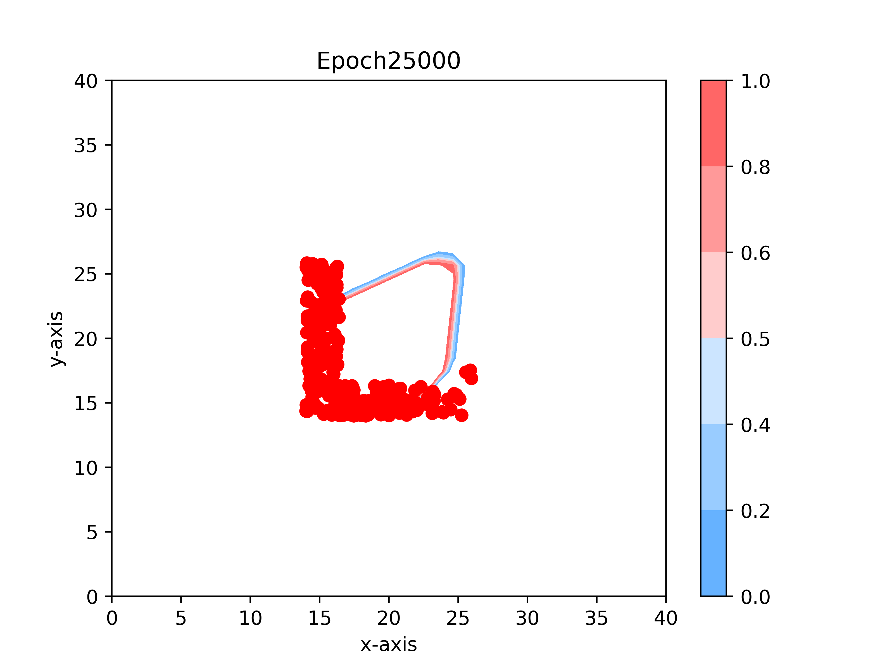
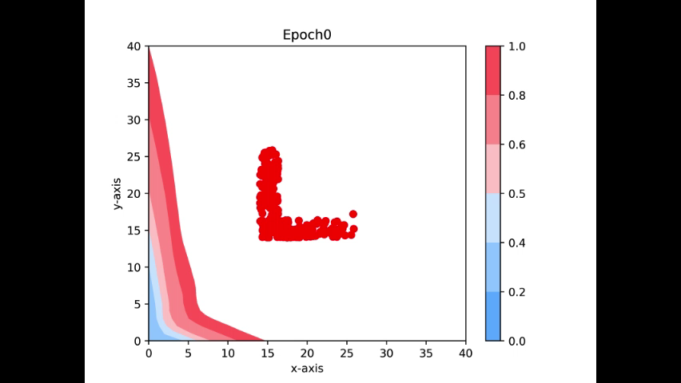
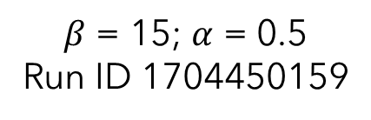
Without Outline Loss
$β$ = 15; $α$ = 0.5
Run ID 1704450159

Slide 25


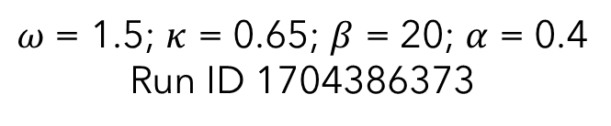
With Outline Loss
$ω$ = 1.5; $κ$ = 0.65; $β$ = 20; $α$ = 0.4
Run ID 1704386373

Slide 26
With vs Without Outline Loss
With Outline Loss
Without Outline Loss

Slide 27
Outline Loss on MNIST and CIFAR-10
Asymmetric Numbers!
MNIST | Anomaly Class AUPRC
Version | 0 | 1 | 2 | 3 | 4 | 5 | 6 | 7 | 8 | 9 | Mean | Stdev
Paper result | 90.5 | 92.4 | 90.3 | 85.6 | 81.1 | 84.2 | 84.7 | 87.8 | 84.9 | 72.2 | 85.37 | 5.47
Improved | 94.1 | 93.5 | 89.3 | 86.6 | 77.6 | 83.4 | 90.8 | 88.4 | 90 | 76.8 | 87.05 | 5.73
Outline Loss | 93.8 | 93.3 | 92.1 | 86.8 | 81.1 | 81.7 | 92.1 | 91.4 | 88.2 | 79.1 | 87.96 | 5.24
CIFAR-10 | Anomaly Class AUROC
Version | 0 | 1 | 2 | 3 | 4 | 5 | 6 | 7 | 8 | 9 | Mean | Stdev
Paper result | 63.5 | 63.3 | 59.2 | 60.1 | 65.1 | 64 | 62 | 61 | 68.7 | 69 | 63.59 | 3.14
Improved | 67.5 | 54.9 | 60.9 | 57.6 | 62.2 | 61 | 62.9 | 60.6 | 64.8 | 59.2 | 61.16 | 3.37
Outline Loss | 65.2 | 60.9 | 60 | 59.7 | 61 | 60.6 | 63.8 | 62 | 67.9 | 61.1 | 62.22 | 2.49

Slide 28
Summary
Hypothesis confirmed: Excellent robustness using sharp decision boundary. Further improved with Outline Loss.
Genius idea: Simple and effective
A modular idea: Integrable to many improvements made on GAN
Low performance ceiling when used in its own

Slide 29
References
[1] Ngo, Phuc Cuong, et al. "Fence GAN: Towards better anomaly detection." 2019 IEEE 31St International Conference on tools with artificial intelligence (ICTAI). IEEE, 2019.
[2] Lucas Deecke, Robert Vandermeulen, Lukas Ru, Stephan Mandt, and Marius Kloft. Anomaly detection with generative adversarial networks. 2018.
[3] Han, Xu, Xiaohui Chen, and Li-Ping Liu. "GAN ensemble for anomaly detection." Proceedings of the AAAI Conference on Artificial Intelligence. Vol. 35. No. 5. 2021. Available: https://arxiv.org/abs/2012.07988
[4] Mirza, Mehdi, and Simon Osindero. "Conditional generative adversarial nets." arXiv preprint arXiv:1411.1784 (2014).
[5] Li, Fei-fei et. al. “Convolutional Neural Networks for Visual Recognition.” [MOOC] Stanford Online Course. 2017. Available: https://www.youtube.com/watch?v=5WoItGTWV54

Slide 30


Thank you
Timothy Antoni
timothy.antoni@gmail.com

Slide 31
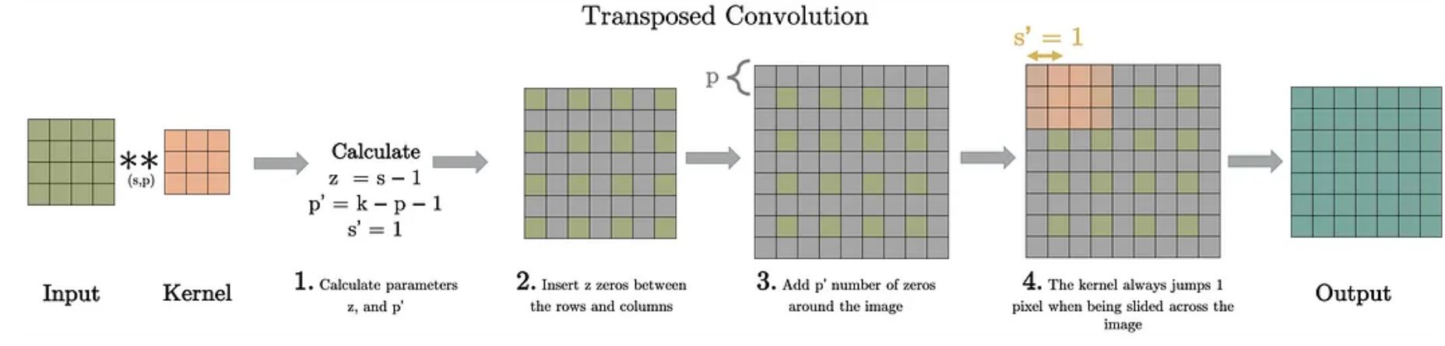
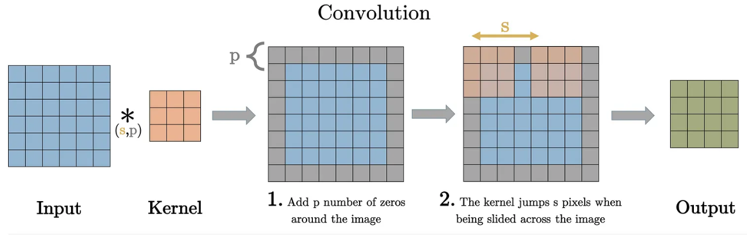
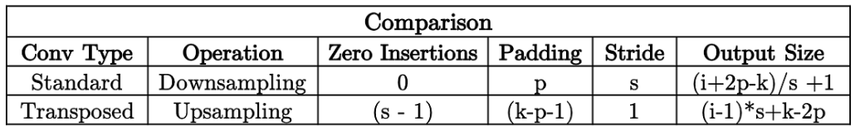
Appendix (Transposed Convolution)

Slide 32
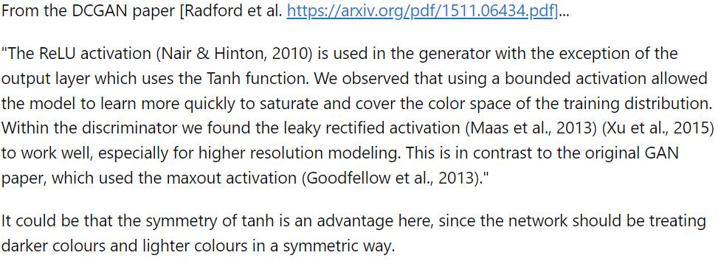
Appendix (Leaky ReLU, Tanh)

Slide 33
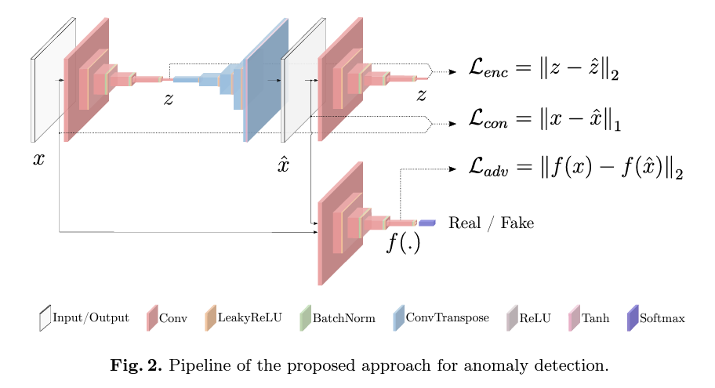
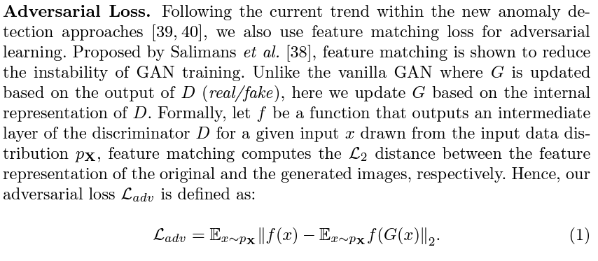
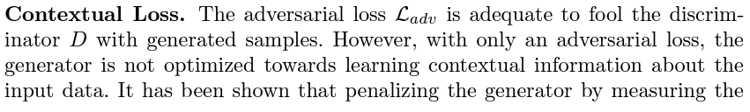
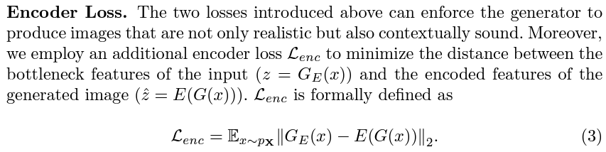
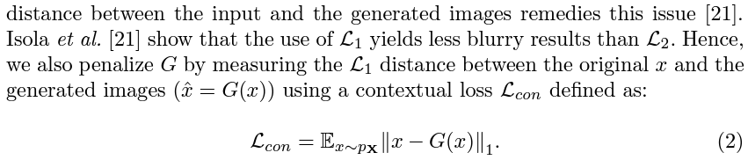
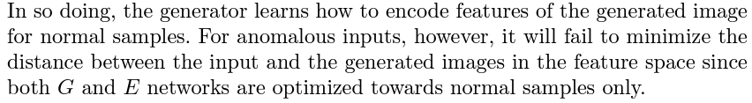
Appendix (GANomaly)

Slide 34

Appendix (GAN vs predecessors)

Slide 35

Appendix (GeoTrans)

Slide 36

Appendix (Gamma’s Impact)

Slide 37

Limitations and Improvements (3)
3. Training Improvements:
Use Scheduler (ReduceLearningRateOnPlateau)
Use EarlyStopping
Ensembling [3]

Slide 38


Without Outline Loss (~10 runs)

Slide 39

Limitations and Improvements
4. Use Embeddings – similar to cGAN [4] – not strongly applicable

Slide 40
Implementation in PyTorch
Link: https://github.com/amothytintoni/Fence_GAN_torch/tree/main
Platform | PyTorch | Keras
Advantages | More Object-Oriented | High Abstraction
 | More Tunable | Simpler training loop
 | Easier Parallelization | Better Visualization

Slide 41
Timeline
Title
To start a presentation, go to the Slide Show tab, and select From Beginning.
Title
To display Presenter view, in Slide Show view, on the control bar at the bottom left select the three dots, and then Show Presenter View.
Title
During your presentation, the speaker notes are visible on your monitor, but aren't visible to the audience.
Title
The Notes pane is a box that appears below each slide. Tap it to add notes.
Title
If you don’t see the Notes pane or it is completely minimized, click Notes on the task bar across the bottom of the PowerPoint window.

